Slide 1
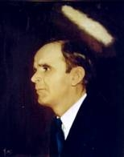

WHO WILL BE JESUS TODAY
He came home from work last night to find that she was gone,
This was certainly his first Sunday setting
(sitting) in the pew alone,
There are whispers all around him his heart breaks in two
He is wondering who will reach out and help him make it through.

Slide 2
CHORUS
Up from the grave He arose
With a mighty triumph O’er His foes;
He arose a Victor from the dark domain,
And He lives forever with His Saints to reign,
He arose, He arose Hallelujah.
Christ arose.

Slide 3
Vainly they watched His bed,
Jesus my Saviour
Vainly they sealed the dead,
Jesus my Lord.
Death cannot keep his prey,
Jesus my Saviour
He tore the bars away, Jesus, my Lord.

